Slide 1
TOPIC: ALKENES
Dr. K. MAHMOODAH PARVEEN
ASSISTANT PROFESSOR
PG & RESEARCH DEPARTMENT OF CHEMISTRY
JAMAL MOHAMED COLLEGE
TRICHY-20

Slide 2
Definition of Alkenes
Alkenes are hydrocarbons that contain carbon carbon double bond (C=C).
The general formula of alkenes are C_{n}H_{2n} .
. Alkanes are saturated with hydrogens, while alkenes are two hydrogen less than alkanes. Thus it is known as unsaturated hydrocarbons.

Slide 3
ALKENES
Alkenes are a class of hydrocarbons (e.g, containing only carbon and hydrogen) unsaturated compounds with at least one carbon-to-carbon double bond.
Another term used to describe alkenes is olefins.
Alkenes are more reactive than alkanes due to the presence of the double bond.

Slide 4
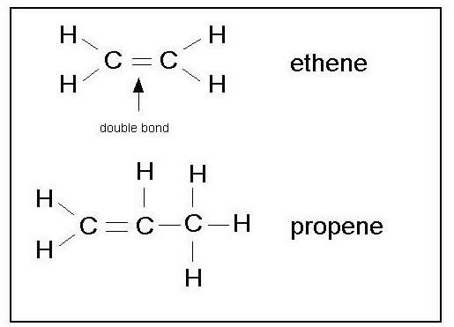
EXAMPLE OF ALKENES

Slide 5
PHYSICAL PROPERTIES
Lower alkenes are gases in room temperature. As the carbon chain increases the alkenes are liquid and the longer chain alkenes are solid in room temperature. Most of the alkenes are colourless and odorless.
As alkenes have no polarity. It sparingly dissolved in water and readily dissolved in organic solvent.
The IR spectrum shows C-H stretching at 3000-3100 cm⁻¹ and C=C stretching at 1620-1680 cm⁻¹.
Alkenes are lighter than water.
Boiling point of alkenes show a gradual increase with an increasing molecular mass of chain length, this indicates that the inter molecular attraction becomes stronger with the increasing the size of the molecule.

Slide 6
Chemical Properties of Alkenes
Alkenes are unsaturated compounds, which makes them highly reactive. Most of these chemical reaction occur at the Carbon-Carbon double bonds. This makes alkenes far more reactive than alkanes. Alkenes undergo three types of main reactions, which are as follows
Addition Reactions
Addition of Hydrogen
Addition of Halogens
Addition of Halides
Addition of Water
Oxidation Reactions
Combustion Reaction
Oxidation by Pottasium Permanganate

Slide 7
Alkenes undergo sp² hybridization. In sp ² hybridisation, one s orbital combines with two p orbitals to form three equivalent sp ² hybrid orbitals.
They have a trigonal planar arrangement, and the angle between two orbitals is 120 degrees.

Slide 8
WITTIG REACTION
The Wittig reaction or Wittig olefination is a chemical reaction of an aldehyde or ketone with a triphenyl phosphonium ylide (often called a Wittig reagent) to give product of an alkene and triphenylphosphine oxide.
It is widely used in organic synthesis for the preparation of alkenes.

Slide 9
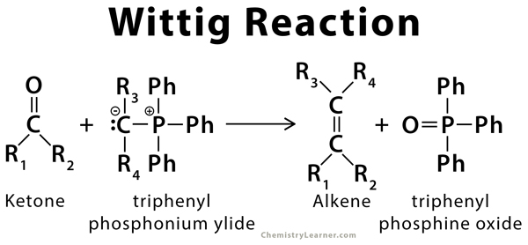

Slide 11
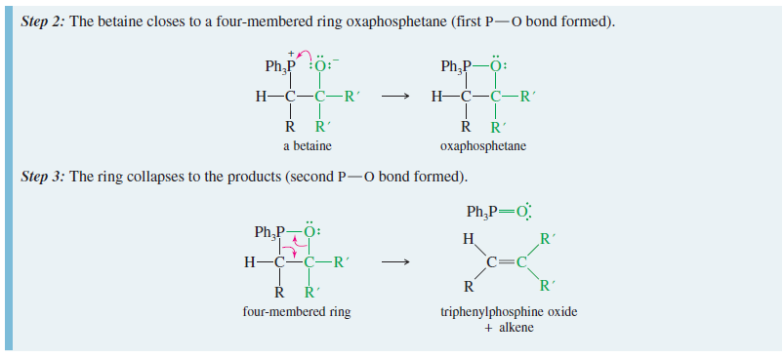

Slide 12
CHEMICAL PROPERTIES OF ALKENES
Alkenes are chemically more reactive than
alkanes.
This because alkenes are unsaturated hydrocarbons that have a double bond, C=C between two carbon atom.
Almost all of the chemical reactions of alkene occur at the double bond.

Slide 15
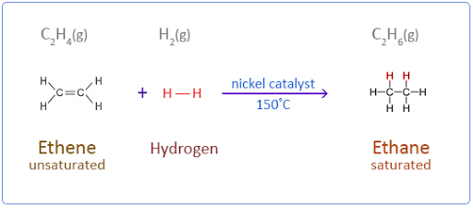
ADDITION REACTION WITH HYDROGEN

Slide 16
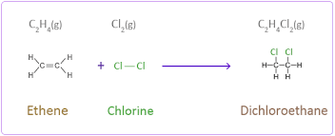
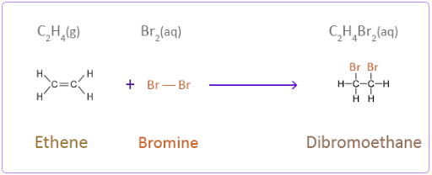
ADDITION REACTION WITH HALOGEN

Slide 17
THANK YOU

